Slide 1
Workshop 1:
HTML, CSS,
Advanced CSS
By Sin Yan and Xiao Thong

Slide 2
Hello! We are NYP LIT
NYP Ladies in Tech is the newest of the four special interest groups
Our mission is to empower women of our generation

Slide 3
Contents
1
2
3
Introduction + Photo Taking
Recap basics (HTML, CSS)
Advanced css
4
5
Practical
Debrief

Slide 4
Basic HTML

Slide 5
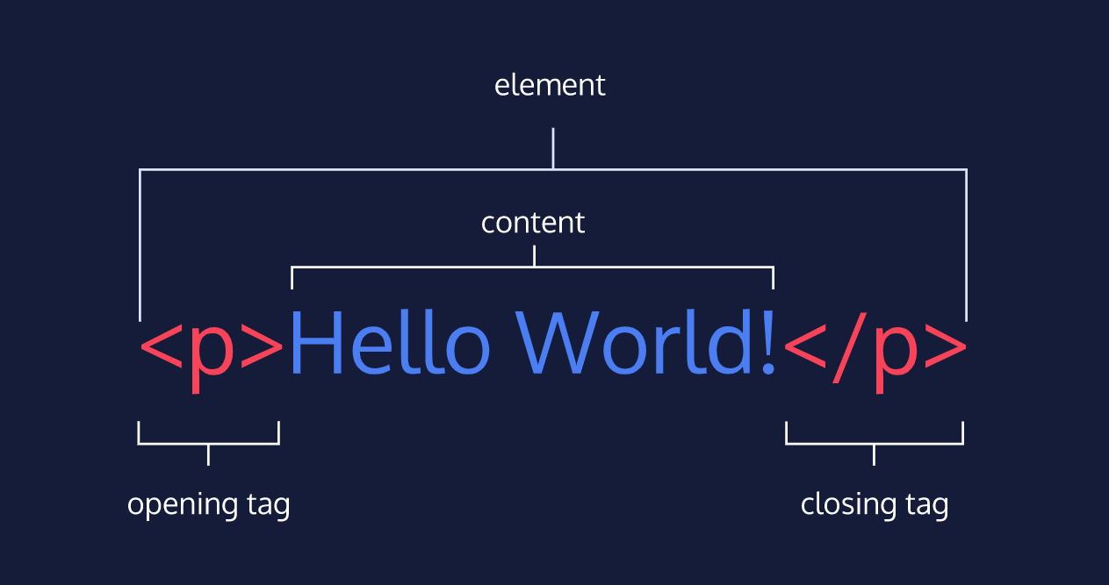
Anatomy
Each element consists of an opening tag, content and closing tag.

Slide 6
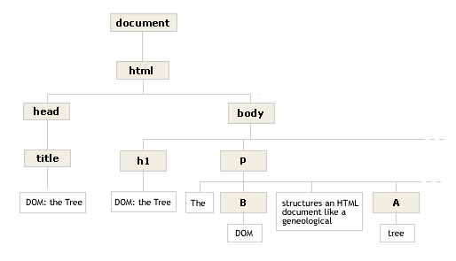
Structure and Family Tree
<html></html> - html tag
<head></head> - head tag
<body></body> - body tag
<title></title> - title tag
Title describes the name of the webpage.
head is the parent of child
title is the child of the head
h1 and p are sibling tags

Slide 7
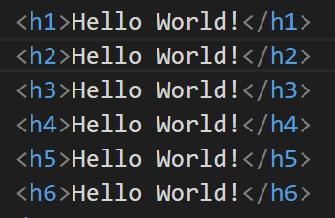
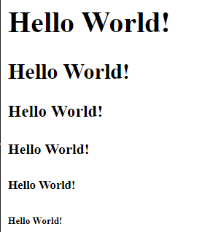
Headings
<h1></h1>,<h2></h2>,<h3></h3>,<h4></h4>,<h5></h5>,<h6></h6>
There are 6 heading tags in HTML from h1(largest) to h6(smallest).
Notes:
There are 6 headings from h1 to h6. H1 is the largest heading that is used for main headings. Whereas, other smaller headings are used for subheadings.

Slide 8
Texts and Lines
There are different tags that can be used to display,style texts and customize lines.
Texts
<p></p> - to contain a block of plain text.
<span></span>- to contain short pieces of text or other HTML
<em></em> - to render text as italic emphasis
<strong></strong> - to render text as bold emphasis
Lines
<br></br> - to create an empty space in between the elements,new line for text
<hr></hr> - to create a visible horizontal line

Slide 9
Division And Anchor
Division tags are containers that divides a page into sections. These tags are useful for grouping different HTML elements together and apply the same style for the elements.
<div></div> - division tag
<div id=”container”> - specify the id of the div tag
<div class="city"> - specify the class of the div tag
Anchor tag can be used to provide hyperlinks in a webpage.
<a href=”info.html” target=”_blank”></a>
href provides the link of the tag
target specifies how to open the linked document

Slide 10
Media
There are different tags and attributes to use for different types of media in HTML.
<img src=”profile.jpg” alt=”profile”/>
src provides the source of the image
alt provides the alternative text when image did not load
<video src=”video.mp4” width=”300” height=”240” controls></video>
src provides source of the video
width provides width of the video in pixels
height provides height of the video in pixels
controls provide video controls for the video

Slide 11
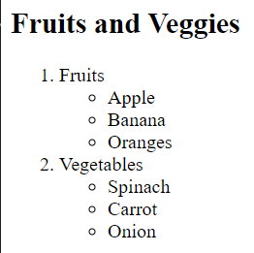
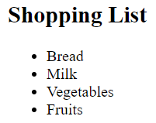
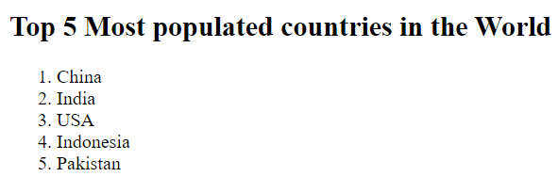
Lists
There different tags to create different types of list.
These tags can also be used to create a nested list of different list types.
<li></li> - list items
<ol></ol> - ordered list
<ul></ul> - unordered list

Slide 12
Table
There are different tags that can be used to create a table.
<table></table> - table
<tr></tr> - table row
<th></th> - table heading
<td></td> - table data
<thead></thead> - table head
<tbody></tbody> - table body
<tfoot></tfoot> - table footer
Notes:
<table></table> is used to create a table in HTML.
<tr></tr> is used to create a table row.
<th></th> is used to create the table heading(which is for the first row of the table).
<td></td> is used to create table data that is contained in a table row.
<thead></thead> is used to create the table head which is used to enclose the table heading( first row of table) in the table head.
<tbody></tbody> is used to create the table body which is used to enclose all the table rows except the table heading(first row of table) and the table footer(last row of table), in the table body.
<tfoot></tfoot> is used to create a table footer which is used to enclose the bottom row of table in the table footer.

Slide 13
Table
These attributes are included in these tags to provide customization for the table.
<td colspan=”2”> - No of columns the table data cell spans to
<td rowspan=2”> - No of rows the table data cell spans to
<th scope=” col ”> - Specify that the header cell is for a column
<th scope=” row ”> - Specify that the header cell is for a column
Notes:
<td colspan=” “> is used for the no of columns the table data cell spans to. For example,<th colspan=”2”> is used to show that the table data cell is span to 2 columns. This means that the table data cell will occupy 2 columns.
<td rowspan=” “> is used for the no of rows the table data cell spans to. For example,<th rowspan=”2”> is used to show that the table data cell is span to 2 rows. This means that the table data cell will occupy 2 rows.
<th scope=” “> helps to specify the heading depending on the scope attribute. For example, <th scope=”col”> specify that the heading is for a column.Whereas, <th scope=”row” >specifies that the heading is for a row.

Slide 14
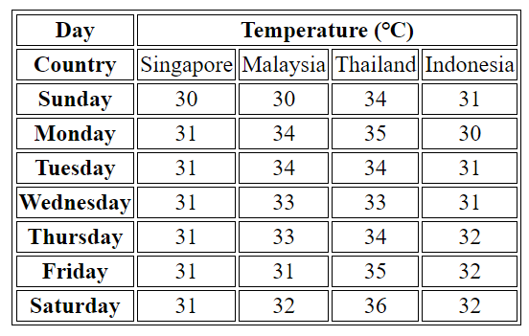
Table Example
Here is an example of a table that can be made using HTML.

Slide 15
Forms
There are different tags that you can use to create forms.
<form></form> - form
<input> - input
<label></label> - label
<textarea></textarea> - textarea
<select></select> - select
<option></option> - option
<datalist></datalist> - datalist
Notes:
<form></form> is used to create a form in HTML.
<input></input> is used to create the input field for the form.
<label></label> is used to create the label for the field.
<textarea></textarea> is used to create a text area field for the user to place a large amount of text.
<select><select> is used to create a select field for users to choose an option from the field for input field types such as
<option></option> is used to create an option field for users to choose an option from the list of options under select field for input types such as

Slide 16
Forms
These attributes are included in these tags to provide customization for the form.
<form action =”/submit.html” method = “get”>
<form action =”/submit.html” method = “post”>
action - specifies where the form data goes to
method - specifies the sending of data using get/post method
<label for=”username”> - to specify the label for input field id attribute
<textarea id="blog" name="blog" rows="5" cols="30">
specifies the number of rows and columns the field occupies
Notes:
Differences between the get(GET) method and post(POST) method
GET
In GET method, values are visible in the URL.
GET has a limitation on the length of the values, generally 255 characters.
GET performs are better compared to POST because of the simple nature of appending the values in the URL.
This method supports only string data types.
GET results can be bookmarked.
GET request is often cacheable.
GET Parameters remain in web browser history.
POST
In POST method, values are not visible in the URL.
POST has no limitation on the length of the values since they are submitted via the body of HTTP.
It has lower performance as compared to GET method because of time spent in including POST values in the HTTP body.
This method supports different data types, such as string, numeric, binary, etc.
POST results cannot be bookmarked.
The POST request is hardly cacheable.
Parameters are not saved in web browser history.
There are many differences between the 2 methods, but the most important part is which method should you use for the form data. For sensitive and personal data, post method should be used as it is a secure method for form data and the data would not show up in the url link after submission(Using get method for these data would cause these data to appear in the url link, which you do not want since you want to maintain the confidentiality and privacy of user data. By using post method, the user data would be protected and the confidentiality of data would not be compromised).
You can read more on the get and post method here. https://www.guru99.com/difference-get-post-http.html

Slide 17
Forms
These attributes are included in these tags to provide customization for the form.
<input id=”username” name=”username” type=”text”>
<input type="submit" value="Send">
specifies the id, name, type, value of the input field
type examples - text, password, number, range, checkbox, radio, submit
For input type=”number”/ input type=”range”,
<input id="years" name="years" type="number" step="1">
<input id="volume" name="volume" type="range" min="0" max="100" step="1">
step - specify the increase and decrease value of the number
min/max - specify the minimum/maximum number of the range

Slide 18
Forms
Here are some examples of input types.
<input type =”text”> - specify the input type of a input field
<input type =”password”> - specify the input type for password field
<input type =”number”> - specify the input type for number field
<input type =”range”> - specify the input type for range field
<input type =”checkbox”> - specify the input type for checkbox field
<input type =”radio”> - specify the input type for radio field
<input type="submit"> specify the input type for submit field

Slide 19
Forms
These attributes are included in these tags to provide customization for the form.
For Dropdown list,
<select id="lunch" name="lunch"> - specifies the id and name of the select field
<option value="pizza">Pizza</option> - specifies the value of the option field
For Datalist Input,
<input type="text" list="cities" id="city" name="city">
list specifies the list name which associates with datalist id.
<datalist id="cities">
specifies the id of the datalist field which associates with input list
<option value="New York City"></option> - specifies the value of the option field

Slide 20
Form Validations
There are different ways to do form validations.
<input id="allergies" name="allergies" type="text" required>
required attribute to inform users that they have to fill up this input field
<input id="guests" name="guests" type="number" min="1" max="4">
min and max specify the minimum and maximum number
<input id="summary" name="summary" type="text" minlength="5" maxlength="250" required>
minlength and maxlength specifies the minimum and maximum length of text in terms of characters
<input id="payment" name="payment" type="text" required pattern="[0-9]{14,16}">
pattern attribute assigns to a regex(regular expression) for form input

Slide 21
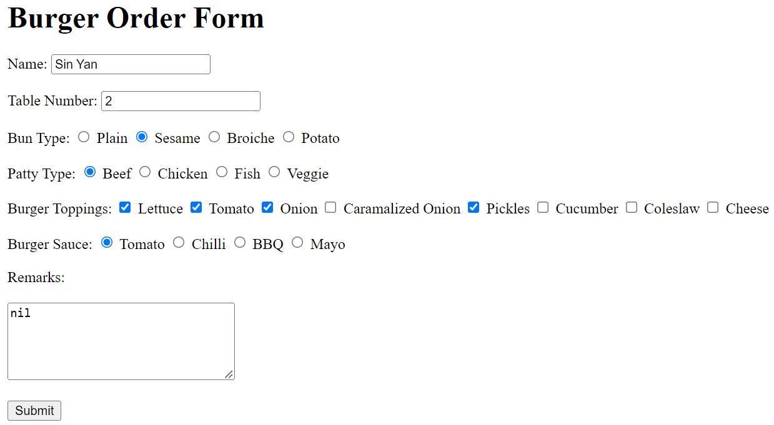
Form Example
Here is an example of a form that can be made using HTML.

Slide 22
Semantic HTML
There are different tags that can be used in semantic HTML.
<header></header> - header - to replace <div id=”header”>
<main></main> - main - to replace <div id=”main”>
<footer></footer> - footer - to replace <div id=”footer”>
<section></section> - section - to replace <div id=”section”>
<article></article> - article - to hold content such as text and media that make sense on its own
<aside></aside> - aside - to mark additional information

Slide 23
Semantic HTML
There are different tags that can be used in semantic HTML.
<figure></figure> - figure - to encapsulate media
<figcaption></figcaption> - figcaption - to describe the media
<audio></audio> - audio - to embed audio content
<source></source> - source - to encapsulate the audio link
<embed/> - embed - to embed any other media type such as gif

Slide 24
Semantic HTML
There are different attributes included in these tags for semantic HTML.
<audio autoplay controls>
autoplay allows audio to play automatically
controls provides audio controls
<source src=”audio.mp3” type=”audio/mp3”>
src provides the source of audio
type specifies the type of audio

Slide 25
Semantic HTML
There are different attributes included in these tags for semantic HTML.
<video autoplay controls loop>
autoplay allows video to play automatically
controls provides video controls
loop allows video to play on repeat
<embed src="download.gif"/>
src provides source of the media

Slide 26
Basic CSS

Slide 27
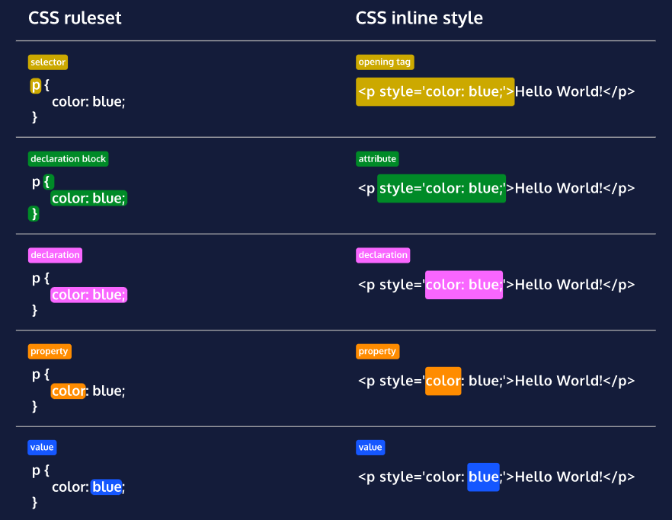
Anatomy

Slide 28
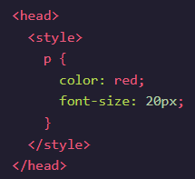
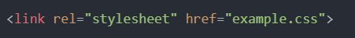
Stylesheet
Internal
CSS codes can be added into the <style></style> under the <head></head> in a HTML file.
External
CSS codes are added in a CSS file.
Link tag to link a css file to a HTML file

Slide 29
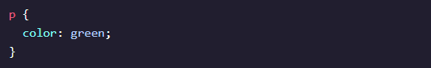
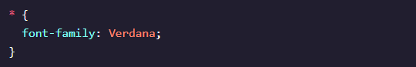


Selectors
Element
Target a specific HTML Element
Universal
Target all elements of any type using *.
ID
Target elements with id attribute using a hex(#) selector

Slide 30


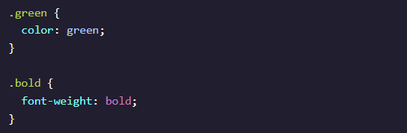
Selectors
Class
Target elements with class attribute using a dot(.) sector
Multiple Classes
Target more than one class name in a class attribute

Slide 31
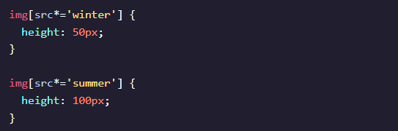

Selectors
Attribute
Target elements that contain attributes
Pseudo-class
Can give elements a different state
Factors such as user interaction and site navigation
Attached to any selector, written as a colon (:)

Slide 32
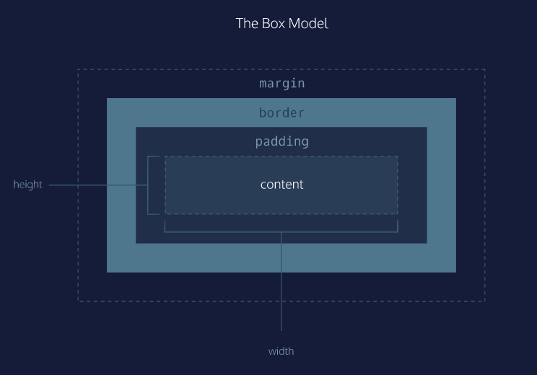
Box Model

Slide 33
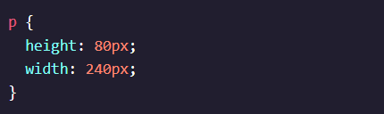
Height and Weight
Allows to control the height and the width of the box.
Set the exact size of an element’s box in px.

Slide 34
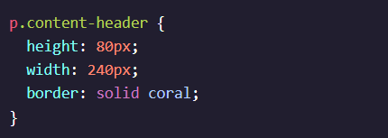

Borders
Line that surrounds an element
Can be set with a specific width, style and color
width - thickness of the border - can be set in px or with keywords such as thin, medium(default) and thick
style - design of the border - can render 10 different styles - eg. none, dotted and solid
color - color of the border - can render colors with different formats- including 140 built-in keywords.

Slide 35
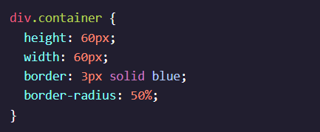

Border Radius
Create a border that is not a square.
Modify the corners of the an element box
Can be expressed in px or %

Slide 36


Padding
Space between the content and border of a box.
Specific about the amount of padding using these properties.
padding-top - amount of padding on top
padding-bottom - amount of padding on the bottom
padding-left - amount of padding on the left
padding-right - amount of padding on the right

Slide 37
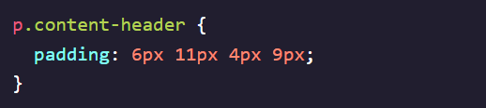
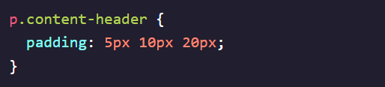
Padding - Shorthand
Specify all padding properties into a single line.
4 values
In clockwise rotation,
padding-top(6px), padding-right(11px), padding-bottom(4px),padding-left(9px)
3 values
padding-left = padding-right
Padding-top(5px), padding-left and padding right(10px), padding-bottom(20px)

Slide 38
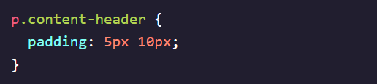
Padding - Shorthand
Specify all padding properties into a single line.
2 values
padding-top = padding-bottom, padding-left = padding-right
Padding-top and padding-bottom(5px), padding-left and padding-right(10px)
1 value
All sides of the padding

Slide 39
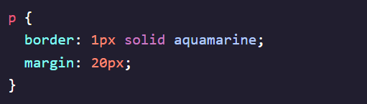
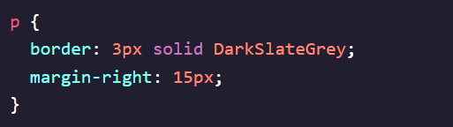
Margin
Space outside of the box.
Specific about the size of margin using these properties.
margin-top - amount of margin on the top
margin-bottom - amount of margin on the bottom
margin-left - amount of margin on the left
margin-right - amount of margin on the right

Slide 40
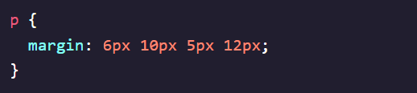
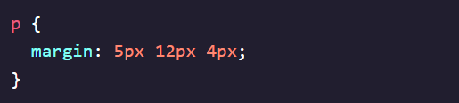
Margin - Shorthand
Specify all margin properties into a single line.
4 values
In clockwise rotation,
margin-top(6px), margin-right(10px), margin-bottom(5px),margin-left(12px)
3 values
margin-left = margin-right
margin-top(5px), margin-left and margin right(12px), margin-bottom(4px)

Slide 41
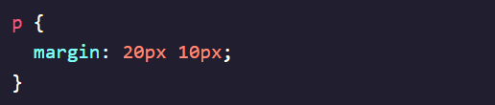
Margin - Shorthand
Specify all margin properties into a single line.
2 values
margin-top = margin-bottom, margin-left = margin-right
margin-top and margin-bottom(20px), margin-left and margin-right(10px)
1 value
All sides of the padding

Slide 42
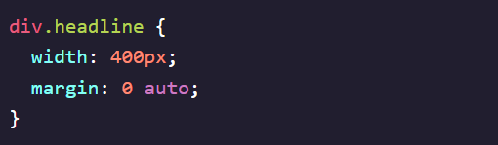
Margin Auto
Allows content to be in the center
margin:0 auto;
0 sets the top and bottom margins to 0 pixels
auto instructs browser to adjust left and right margins until element is centered.

Slide 43
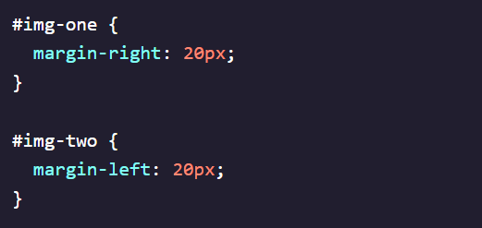
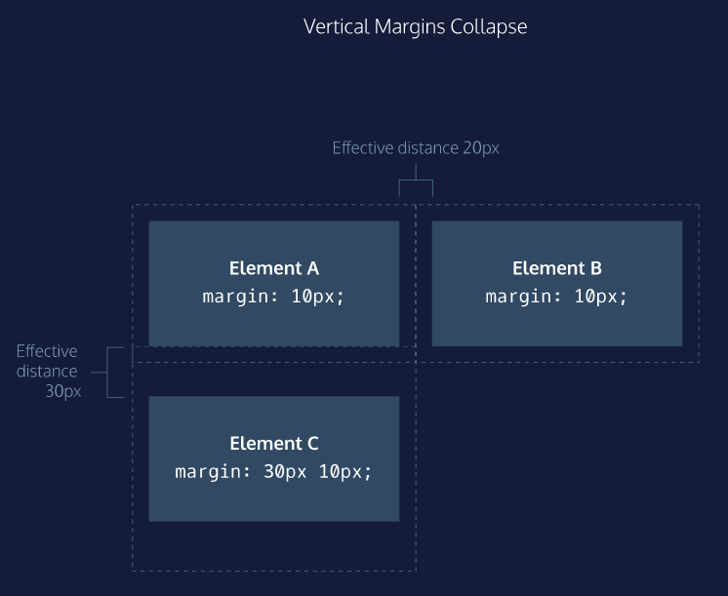
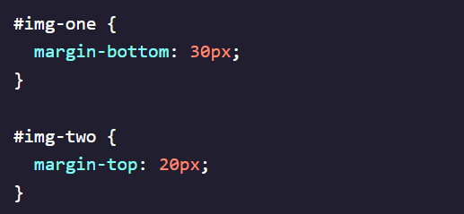
Margin Collapse
Top and bottom margin collapse.
Horizontal margin are added together.

Slide 44
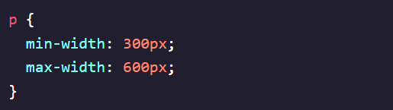
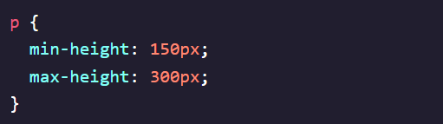
Minimum and Maximum Height and Weight
Width - How narrow or how wide a box is
min-weight - ensures the minimum width of the box
max-width - ensures the maximum width of the box
Height - How tall a box is
min-height - ensures the minimum height of the box
max-height - ensures the maximum height of the box

Slide 45
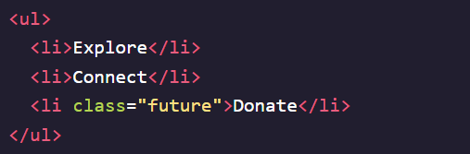
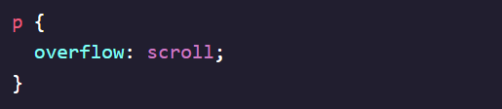
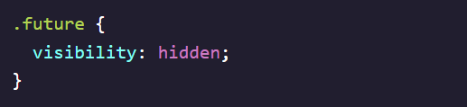
Overflow and Visibility
Controls what happens to content that overflows outside the box
hidden - overflowed content will be hidden
scroll - a scrollbar will added to the box
visible - content will be displayed outside of the box
Controls the visibility of the element
hidden - hides an element
visible - displays an element
collapse - collapses

Slide 46
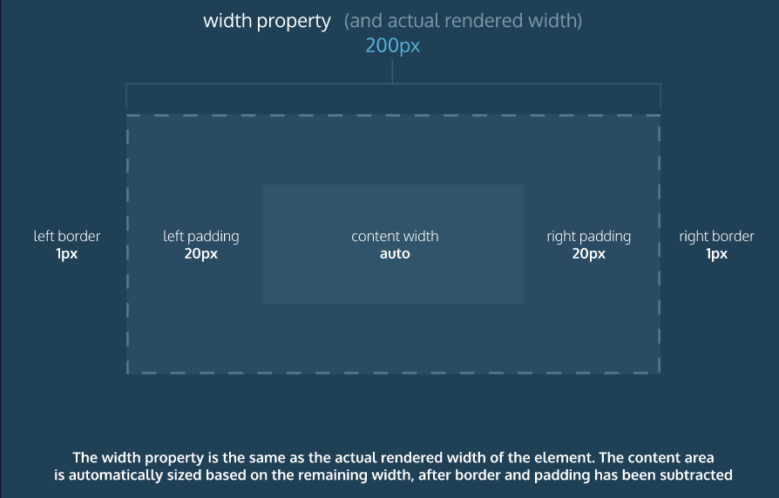
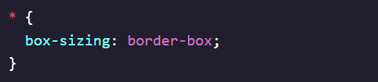
New Box Model
box-sizing - controls the type of box model the browser used
border box helps to avoid dimensional issues in the old box model
Height and width remained fixed.
Border and padding will be included in the box.

Slide 47
Position
There are 5 values for the position property.
static(default)
relative
absolute
fixed
sticky
These values are accompany with offset properties.
top - moves the element down from the top
bottom - moves the element up from the bottom
left - moves the element from the left(to the right)
right - moves the element from the right(to the left)

Slide 48
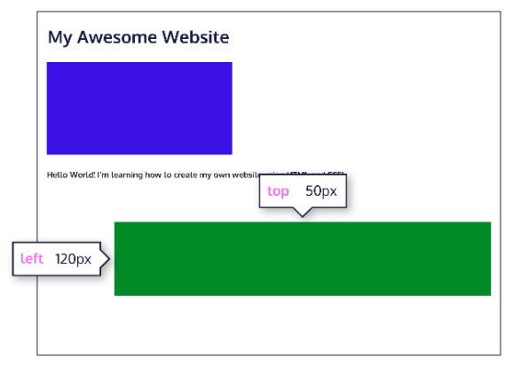
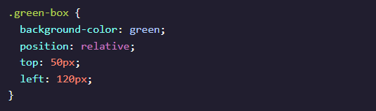
Position: Relative
Relative
Position an element relative to its default static position
Does not specify where the element should be position
Done by accompanying the position with offset properties(in px, em or %)

Slide 49
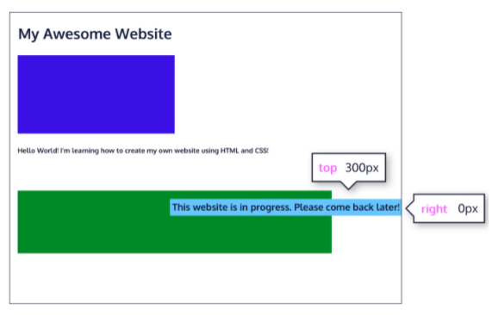
Position: Absolute
All other elements on the page will ignore the element
Positioned relative to its closest positioned parent element

Slide 50
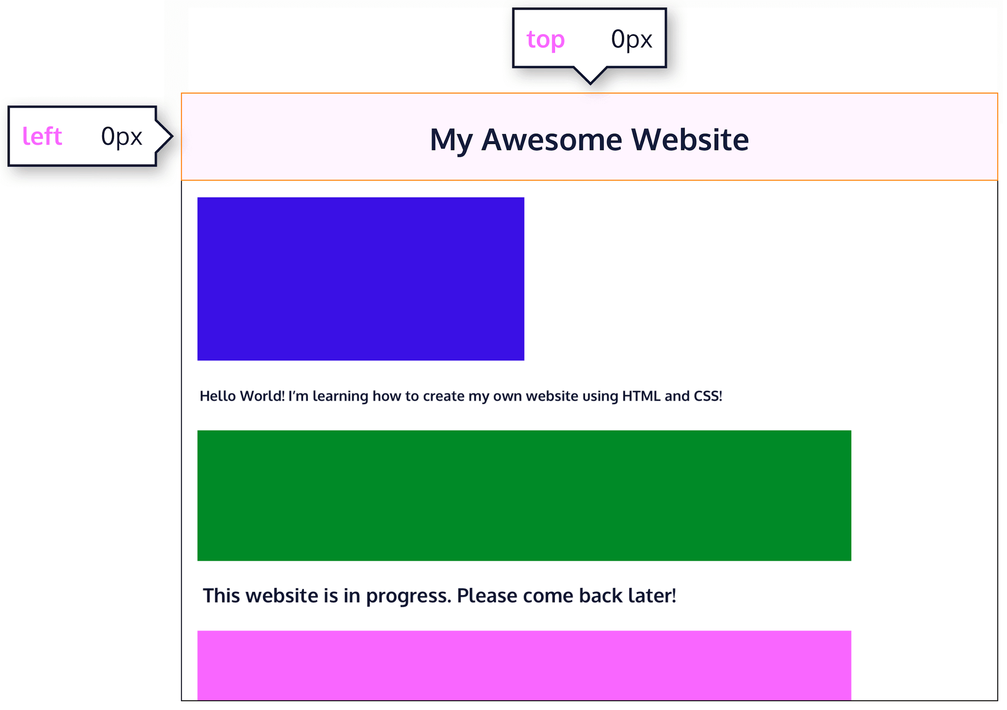
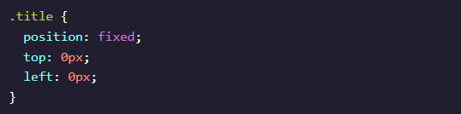
Position: Fixed
Fixed an element to a specific position
Element will always remained in this position even when user scrolls the web page

Slide 51
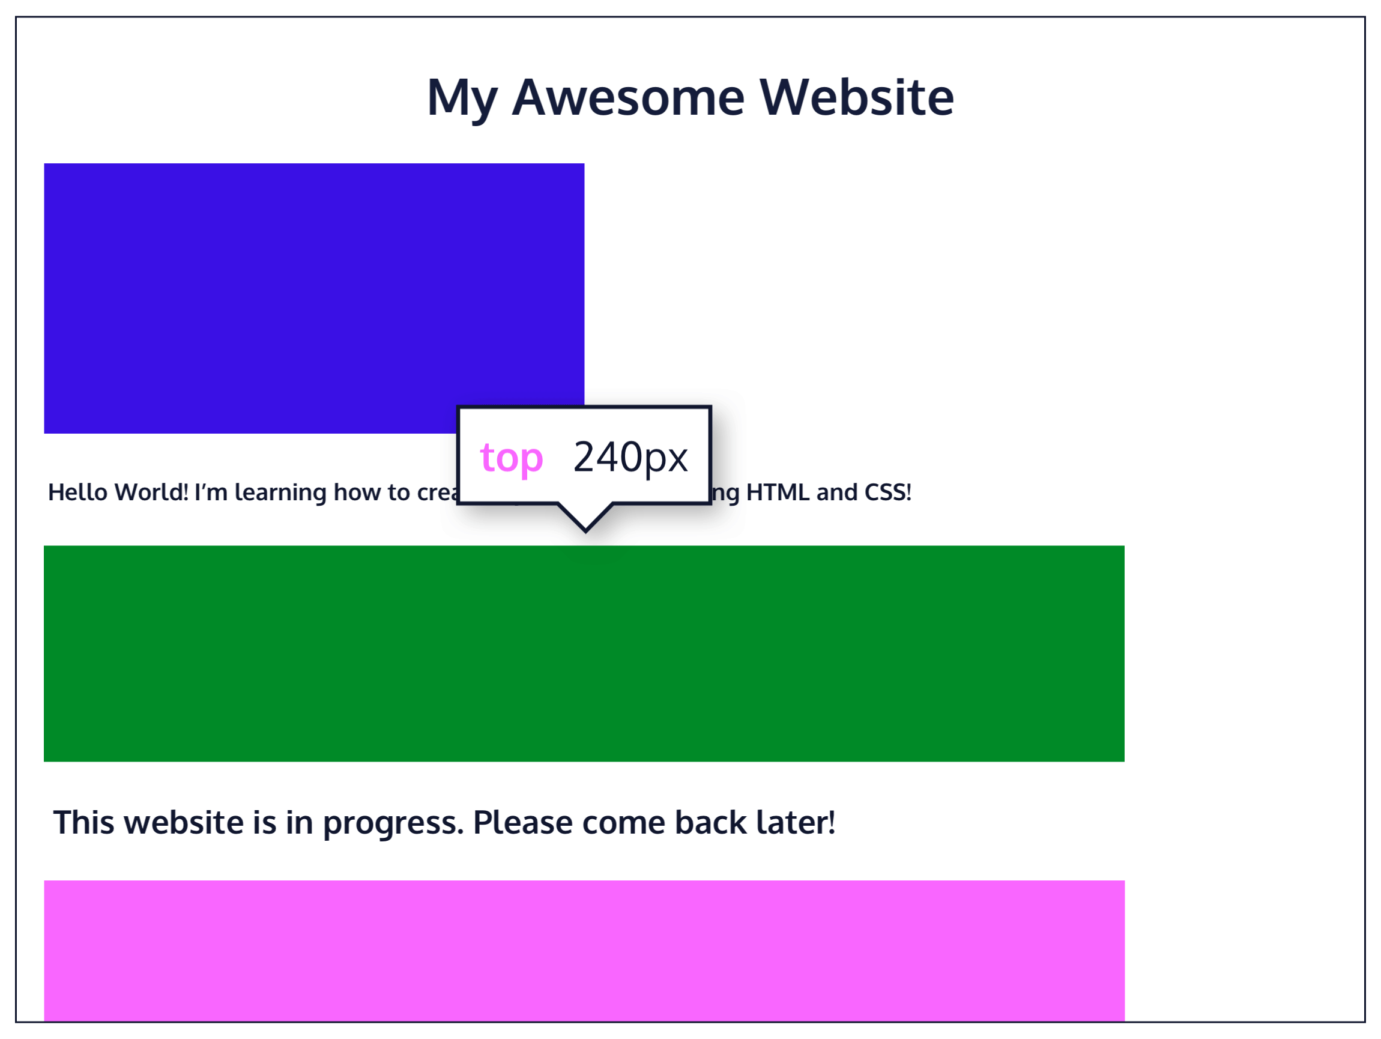
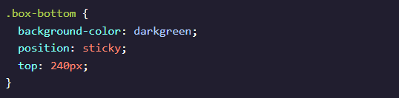
Position: Sticky
Keeps an element to a specific position
Sticks to a specified position as the user scrolled further
Toggled between relative and fixed position

Slide 52
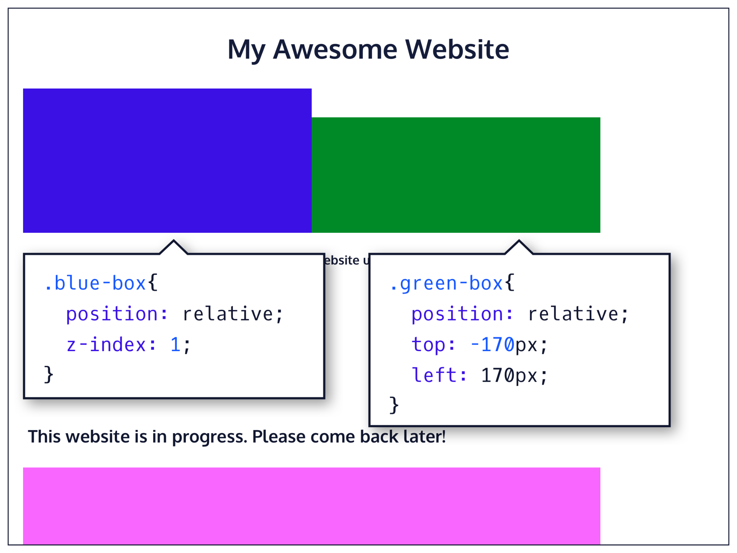
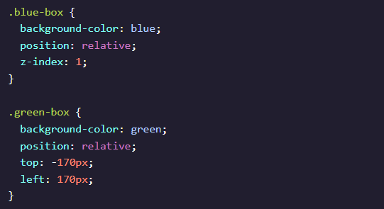
Z - Index
Controls how far back or far forward an element should appear when elements overlap
Thought as the depth of elements
Accept integer values

Slide 53
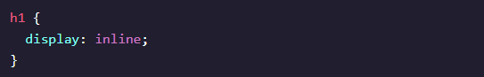
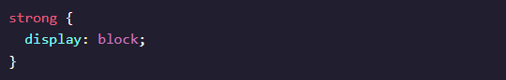
Display Inline and Display Block
Inline
Box wrap tightly around an element(content)
Taking up necessary space to display the content
Cannot be specified using height and weight
Default display for <em>, <strong>, <a>
Block
Not displayed in the same line as the content around them
Fills the entire width by default
Width can be specified
Default display for <h1>-<h6>, <p>, <div>, <footer>

Slide 54



Display Inline-Block
Combines both inline and block features
Can be specified using width and height
Default display for <img/> (image)

Slide 55


Float
Move an element far left or far right
Commonly used for wrapping text around an image
Keyword Values
left - move an element as far left as possible
right - move an element as far right as possible

Slide 56

Clear
Like float, it can float multiple elements
Specifies the behaviour of elements when they bump into each other
Keyword Values
left - left side will not touch any element within the same containing element
right - right side will not touch any element within the same containing element
both - neither side will not touch any element within the same containing element
none - the element can touch either side

Slide 57

Colors
There are 2 color elements for CSS.
foreground Color - color: red ; styles the element’s foreground color
background Color - background-color: blue; styles the element’s background color

Slide 58

Named Colors
Color names can be used to add colors to a webpage
HTML used to recognize 16 color names.
All modern browsers support 140 color names
Examples - red, orange,yellow,green,blue etc
Color names - https://htmlcolorcodes.com/color-names/

Slide 59

Hex Codes/Colors
6 color codes made up of three 2-symbol elements
It begins with a hash character (#) followed by 3 or 6 characters
Uses hexadecimal numbers, ranging from 0 to F
Color combinations - 256^3 (16,777,216)
1st and 2nd digit represent the amount of red
3rd and 4th digit represents the amount of green
5th and 6th represents the amount of blue
Example - Red is #FF0000
Color picker - https://htmlcolorcodes.com/color-picker/

Slide 60

RGB Colors
Uses decimal numbers ranging from 0 to 255
Each of the 3 values represent a color
1st number represent the amount of red
2nd number represent the amount of green
3rd number represent the amount of blue

Slide 61


HSL Colors
Made up of 3 values
1st value represents the hue, refers to an angle on a color wheel.
Example - Red(0°/360°), Green(120°), Blue(240°)
2nd value represents the saturation(intensity and purity) of the color
Range from 0%(grayest) to 100%(richest)
3rd value represents the lightness(how light or dark the colour is) of the color
Range from 0%(lightest) to 100%(darkest)

Slide 62


Color Opacity and Alpha
Alpha/opacity is a value used for the amount of opacity of a color.
It is decimal number ranging from 0(most transparent) to 100(most opaque).
Used in RGB, HSL colours and hex colours
rgb become rgba, whereas hsl become hsla
color: transparent; = rgba(0,0,0,0)
Hex colors: by adding 2 digits to a 6-digit hex code (#52BC8280) or 1 digit to a 3-digit hex code(#F003), range from 00(transparent) to FF(opaque)

Slide 63



Font Family
Font family can be used to state the type of fonts to use for texts.
Single value
Optional to use quotation marks
Multi-word values
Have to use quotation marks
Fallback Fonts and Font Stacks
Backup fonts if preferred font is not available
Font-stack contained similar-looking fonts

Slide 64


Font Family
Font family helps to state the type of fonts to use for texts.
Serif and Sans-serif
2 types of fonts
Serif - Caslon,Georgia, Times New Roman
Sans-serif - Open Sans, Roboto, Lato
Keyword values added as final fallback font
serif; and sans-serif;
Web Safe Fonts
Same across browsers and operating systems
List - https://www.cssfontstack.com/
Online fonts - https://fonts.google.com/

Slide 65

Font Weight
Font weight controls how bold or thin a text appears.
Keyword Values
bold - bold font weight
normal - normal font weight(default)
lighter - 1 font weight lighter than element’s parent value
bolder - 1 font weight bolder than element’s parent value
Numerical Values
range from 1(lightest) to 100(boldest)
font-weight: 400; = font-weight: normal;
font-weight: 700; = font-weight: bold;

Slide 66


Font Style and Font Size
Font style styles the appearance of the text.
Keyword Values
normal - displays text in normal style(default)
italic - displays text in italic style
oblique - displays text in oblique style
Font size controls the size of the font.
Can be measure in px, %
Can be expressed using keyword such as small, medium, large

Slide 67



Text Transformation and Text Layout
Text transform helps to transform text to uppercase or lowercase.Text layout helps to display text within the element’s container.
Keyword Values
uppercase - change all letters to uppercase
lowercase - change all letters to lowercase
Letter Spacing
Horizontal space between each character
Length values such as 2px or 0.5em
Word Spacing
Space between each each word
Length value such as 3px or 0.2em

Slide 68



Text Layout
Line Height
Height of each line containing a text
Number such as 1.2, length value such as 12px, 5%, 2em
Text Align
left - align text to left
right - align text to right
center - align text to center
justify - stretches line so that
each line has equal width

Slide 69


Other
Here are other properties you can use in CSS.
Opacity
Measure of how transparent an element is
Range from 0 (fully transparent) to 1 (fully opaque)
Background Image
Set the element of background to display an image
Using url value to link toi source of image

Slide 70
Advanced CSS

Slide 71
Gradient
Display smooth transitions between two or more specified colors
Types:
Linear gradients
Radial gradients
Conic gradients

Slide 72


Linear Gradient
To create a linear gradient you must define at least 2 color.
Syntax:
background: linear-gradient(direction, color1, color2, ...)

Slide 73


Cont'd

Slide 74

Media Query
It is used to create a responsive web design. It means that the view of a web page differs from system to system based on screen or media types.
Syntax:
@media mediatype and (expression) {// Code content}
Media Types:
all: It is used for all media devices.
print: It is used for printer
screen: It is used for computer screens, smartphones, etc.
speech: It is used for screen readers that read the screen aloud

Slide 75
Hands-on Time!

Slide 76

Footer
Challenges:
Gradient for sub footer (Copyright)
Responsive

Slide 77

Styling Table
Challenges:
Responsive - scroll bar appears when resize the webpage
Different color for odd and even rows (use nth-child)

Slide 78

Animation
An animation allows an element to transition from one style to another gradually.
@keyframes
Keyframes are the foundations on which CSS Animations are built. They define how the animation will look at each stage of its runtime.
Format:
@keyframes animation-name {selector {css-styles;}}
animation-name: Required. Define the name of the animation.
selector: Required. Percentage of the animation duration
0-100%
from (0%)
to (100%)
css-styles: Required.

Slide 79
Animation Properties
animation-name: specifies the names for the @keyframes animation
animation-duration: specifies how long the animation takes to complete (in ms or s)
animation-timing-function: specifies the speed of the animation
linear - has the same speed from start to end
ease - default value. Has a slow start, then fast, before it ends slowly
ease-in - has a slow start
ease-out - has a slow end
ease-in-out - has both slow start and slow end
animation-delay: specifies a delay for the start of an animation
animation-iteration-count: specifies the number of times an animation should be played
number - any number that defines how many times it should be played. Default value is 1
infinite - specifies animation should be played infinite times (forever)

Slide 80
Cont'd
animation-direction: specifies the direction of the animation
normal - Default value. Animation played as normal (forwards)
reverse - Animation is played in reverse direction (backwards)
alternate - Animation is played forwards first, then backwards
alternate-reverse - Animation is played backwards first, then forwards
animation-fill-mode: specifies what value are applied by the animation before and after it is executed
none - Default value. Animation will not apply any properties to the element
forwards - element retain the same animation properties of the last keyframe after the animation completes
backwards - element get the properties of the first keyframe before the start of the animation
both - follow the rules for both forwards and backwards

Slide 81
Const.
animation-play-state: specifies whether animation is running or paused.
paused
running - Default value

Slide 82
Hands-on Time!

Slide 83
Online Resources & Cheat Sheets
HTML
CSS
HTML Cheat Sheets Folder by Codecademy (On Github)
HTML Cheatsheet - http://www.cheat-sheets.org/saved-copy/html-cheat-sheet.png
Codecademy and W3schools
CSS Cheat Sheets Folder by Codecademy (On Github)
CSS Cheat Sheet - https://devhints.io/css
Codecademy and W3schools

Slide 84


Thank you!
Do you have any questions?
Hop over to the get-support voice channel! We will be there till the end of the event, or feel free to drop us a message in get-support text channel
https://nyp-lit.github.io/
@nyp_lit

